Slide 1




CAP6942 – CAPSTONE PROJECT
WIDS DATATHON TEAM
UNRAVELING THE MYSTERIES OF THE FEMALE BRAIN
Final Team Presentation
Team members:
Rosali Gonzalez, Hieu Chu, Wen fong Wang
WiDS Datathon 2025
#WiDSDatathon

Slide 2
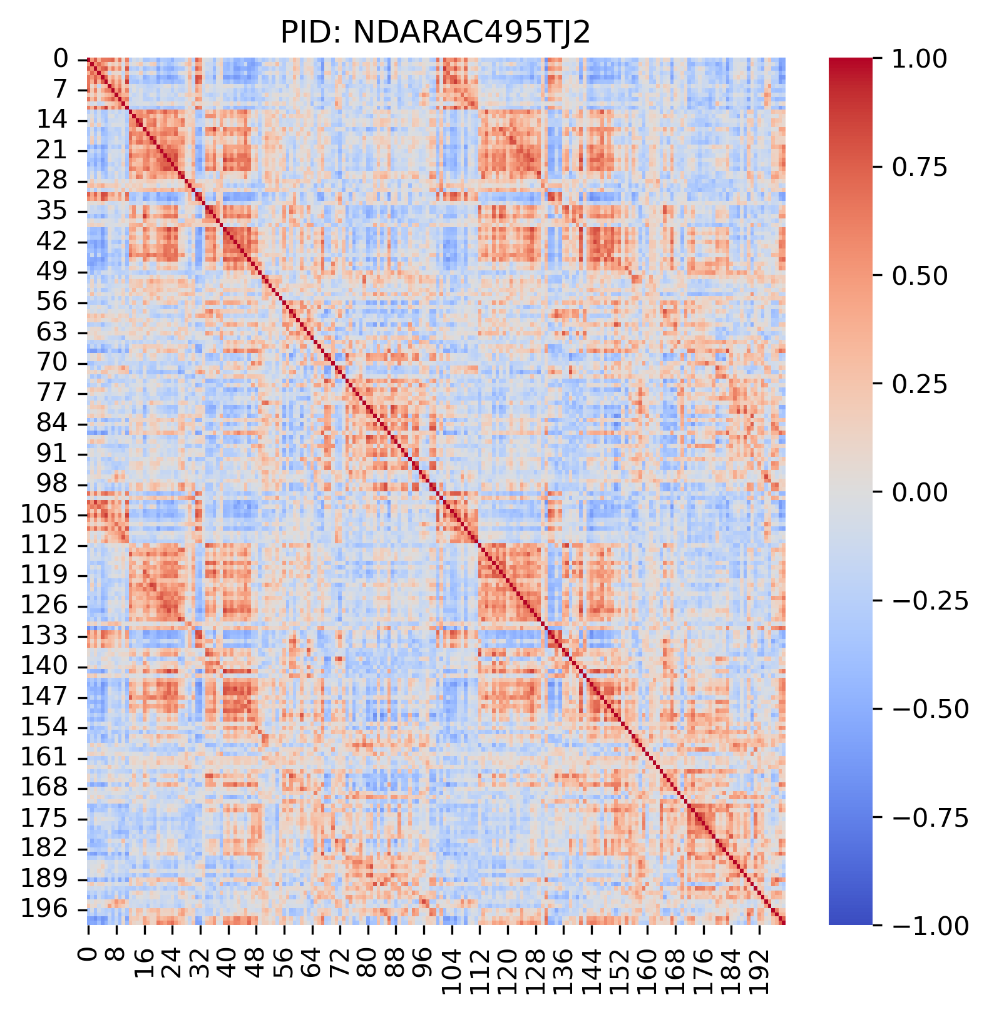
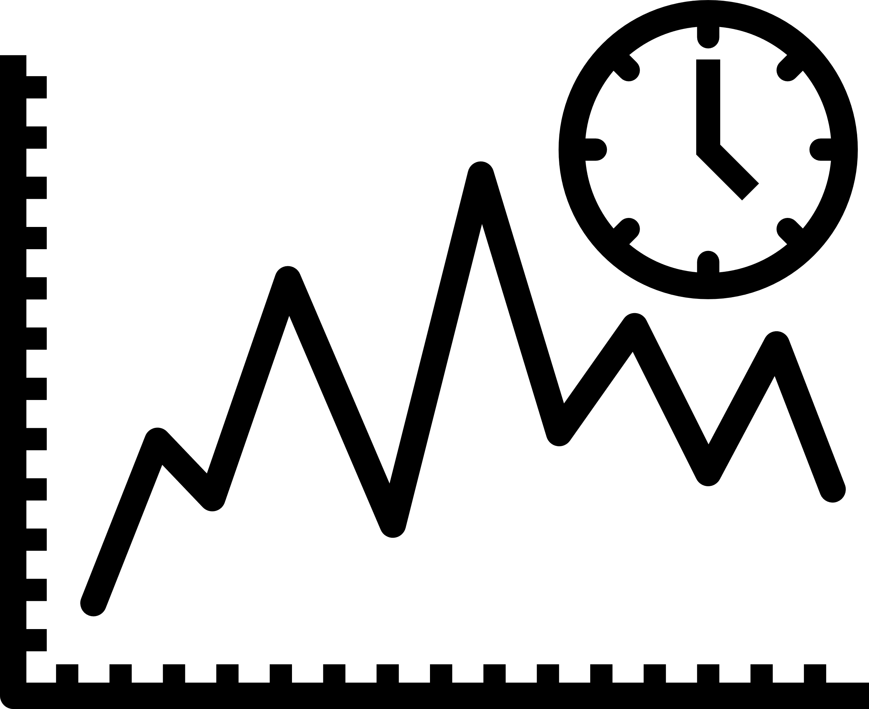

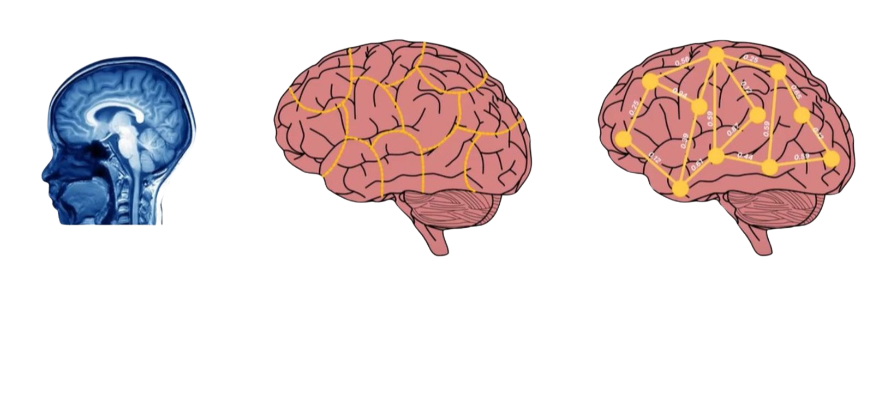
Brain Connectivity Dataset Overview
Measure brain activity to measure brain activity and obtain a time series for each voxel
Group voxels into brain regions and summarize their time series
per region
Compute statistical associations between the time series of different brain regions
Fully connected correlation matrix for brain region interactive with each others

Slide 3

Project Summary
1 |
Sex-Based Brain Development
Explores differences in brain maturation between males and females during childhood and adolescence.
2 |
fMRI & Connectivity Analysis
Uses functional MRI to examine brain connectivity matrices and neural network activity.
3 |
Age Prediction via Machine Learning
Trains models to estimate a child's age based on brain network patterns.
4 |
Clinical & Cognitive Insights
Identifies sex-based differences in brain development and their links to mental health, cognitive function, and neurological disorders, aiming to bridge gaps in neuroscience, enhance diagnostics, and explore AI-driven clinical applications.

Slide 4

Purpose of Project
Address the research gap by focusing on female neurodevelopment, which has historically been understudied.
Analyze how functional brain connectivity differs across sex during adolescence using fMRI data.
Apply machine learning to model age-related brain changes and uncover sex-specific developmental patterns.
Support early diagnosis, intervention, and treatment design for cognitive and mental health conditions.
Showcase the power of AI in neuroscience to drive discovery, enable personalized medicine through sex-specific brain markers, and unlock commercial potential in healthcare, drug development, and education.

Slide 5

Summary Statement
Developed a complete pipeline to predict age from brain connectivity data using machine learning
Discovered statistically significant sex-based behavioral differences derived from brain features
Demonstrated fair model performance across sex and age groups, with lowest errors in mid-adolescents
Applied dimensionality reduction (PCA) to extract meaningful features from high-dimensional fMRI data
Delivered interpretable visualizations to communicate age prediction and behavioral insights
Addressed gaps in brain research by ensuring female representation and bias-aware modeling
Contributed a proof-of-concept for using AI in developmental neuroscience

Slide 6



Project Requirements
Functional Requirements
Process fMRI Brain Data: Extract meaningful features from brain connectivity patterns.
Develop Predictive Models: Train algorithms to estimate age from brain network data.
Generate Insights: Create visual and statistical summaries to understand model behavior and highlight sex-specific trends.
Performance Requirements
Scalable to Large Datasets: Handle high-dimensional brain connectivity matrices.
Meet Accuracy Benchmarks: Achieve competitive prediction performance.
Efficient Computation: Utilize hardware resources effectively for model training and testing.
Quality Requirements
Scientific Validity: Apply valid methods to ensure robust conclusions.
Reproducibility: Create a modular pipeline with potential for full environment capture.
Fairness & Bias Checks: Begin assessing model fairness, especially across sex groups.

Slide 7
Project Plan
Combining CRISP-DM and Agile for Flexible Data Science
1
2
3
4
5
Initial
Project Launch
Data Preparation and Exploration
Model development and optimization
Validation & Insights
Final
Reporting
Reviewed datasets, defined scope & goals
Assigned team roles and outlined risks
Extracted fMRI brain connectivity matrices
Cleaned, normalized, and merged metadata
Performed EDA, feature engineering, and visualized trends
Defined target (age) and applied dimensionality reduction
Trained traditional ML and deep learning models (e.g., Linear Regression, Random Forest, GNNs, Transformers)
Tuned models using grid/random search and validation techniques
Validated models using cross-validation and bias assessment
Evaluated model performance and addressed under/overfitting
Analyzed sex-specific brain connectivity patterns and model behavior
Documented key insights and findings
Built presentation, report, and summary video

Slide 8
Risk Analysis
Risk | Risk Description | Likelihood | Impact | Mitigation Strategy
Business and Data Understanding
Misalignment with Objectives | Unclear project objectives can lead to misdirected project implementation. | Low | High | Involve stakeholders early, set clear objectives, and review with experts regularly.
Lack of Domain Knowledge | Lack of expertise in specific areas (e.g., neuroscience, deep learning) may slow progress.. | Moderate | Moderate | Consult experts, review existing studies, and discuss with mentors to refine goals.
Data Preparation
Handling Missing Data & Outliers | Missing or incorrect data (fMRI/metadata) may affect model accuracy. | Moderate | High | Use reliable methods to detect outliers, and impute missing data (e.g., statistical checks, visualization).
Integration of Metadata and fMRI Data | Errors in merging data if unique IDs are missing or inconsistent. | Low | Moderate | Check unique IDs carefully; verify data after merging to ensure everything aligns correctly.
Data Preprocessing Mismatch with Model | Data preprocessing methods that do not align with the machine learning model can lead to poor performance. | High | High | Ensure preprocessing techniques match model; test different preprocessing strategies and validate results.

Slide 9
Risk Analysis
Risk | Risk Description | Likelihood | Impact | Mitigation Strategy
Modelling
Feature Engineering | Not transforming features in ways that capture underlying patterns may limit model performance. | Moderate | High | Use expert knowledge to create better features; test different transformations and feature selection methods.
Model Optimization | Model performance gets stuck even after optimization | Moderate | High | Recheck data quality, try new features, test different model types (e.g., ensembling, neural networks), and use advanced tuning methods.
Computational Resource Constraints | High computational cost from complex models and tuning slows down the project. | Moderate | Moderate | Plan for enough computing power (GPUs, cloud servers); optimize code and use pre-trained models when possible.
Deployment & Maintenance
Lack of User Feedback | Failure to collect user feedback lead to unnoticed model biases. | Low | Moderate | Regularly collect feedback from users and domain experts; make necessary adjustments.
Delays in Project Timeline | Unexpected technical challenges or data issues can delay progress. | Moderate | High | Set realistic timelines, allow buffer time for unexpected issues, and monitor progress frequently.

Slide 10
Minimum Viable Product (MVP) Goals
Core Research Question:
How do brain networks develop differently across males and females in adolescence?
Build an end-to-end ML pipeline using fMRI brain connectivity data
Predict age based on functional brain networks
Identify sex-based behavioral
and neurological differences
Evaluate model fairness and interpretability across sexes

Slide 11
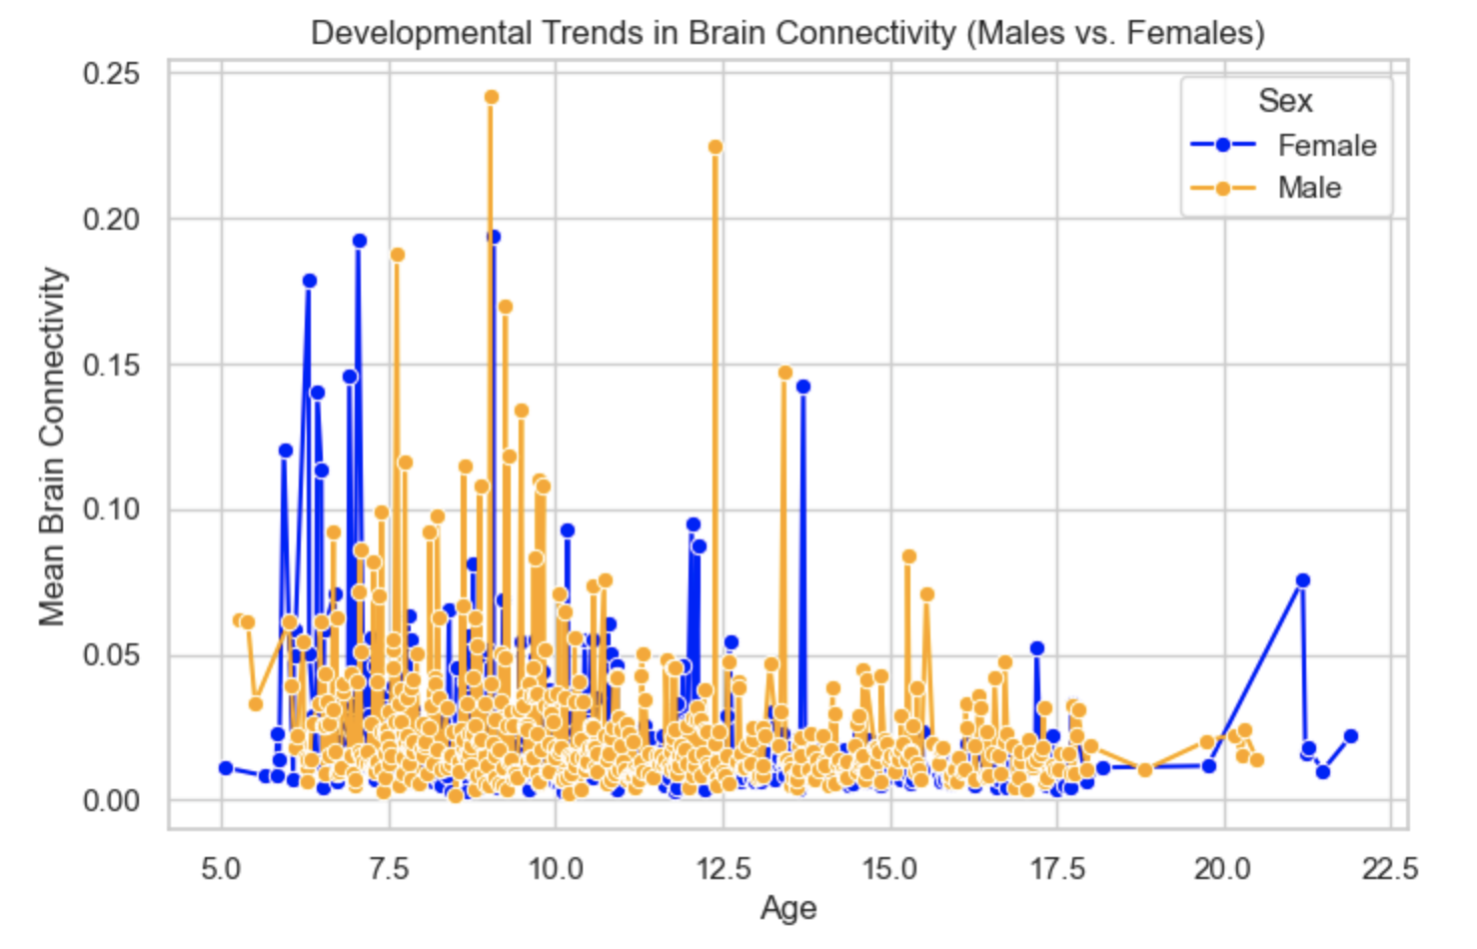
Minimum Viable Product (MVP) Evaluation
Brain Connectivity Trends
Key Insights:
Females showed higher brain connectivity early, peaking around ages 9-11.
Males showed a slower increase with a lower peak around age 10-11.
Both declined over time as the brain matures.
Females showed more anxiety symptoms, while males experienced more attention and impulsivity challenges.

Slide 12
Minimum Viable Product (MVP) Evaluation
Behavioral Differences Across Sexes
Internalizing
Male
0.0096
vs.
0.2581
Female
T-statistic: -3.96 | P-value: 7.88e-05
Females exhibit more anxiety/depression symptoms
Externalizing
Male
0.1494
vs.
0.0046
Female
T-statistic: 2.18 | P-value: 0.0293
Males show more impulsive, aggressive behavior
Attention Factor
Male
0.2195
vs.
- 0.1529
Female
T-statistic: 6.12 | P-value: 1.27e-09
Males struggle more with inattention/hyperactivity

Slide 13
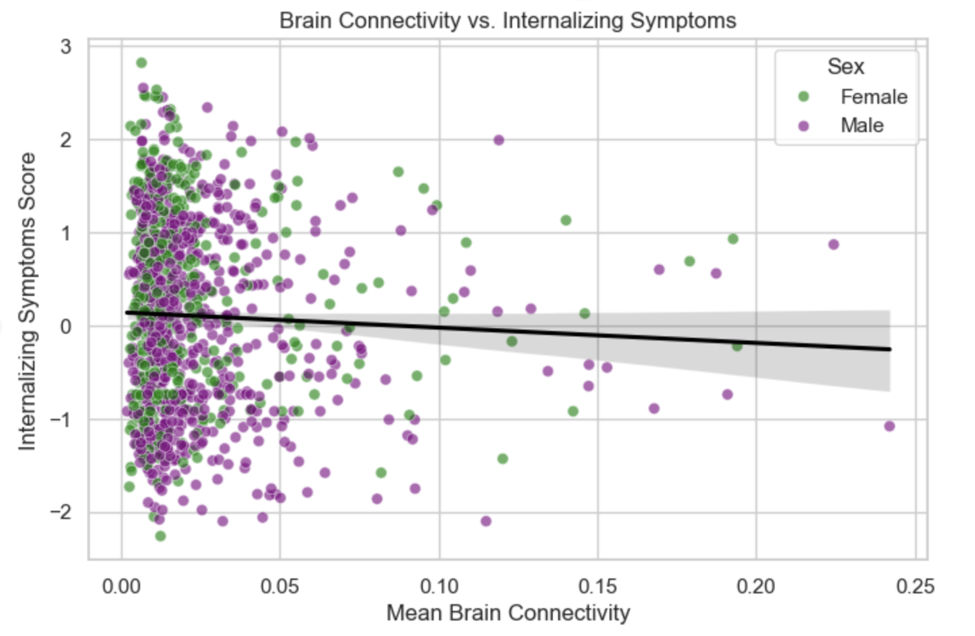
Minimum Viable Product (MVP) Evaluation
Behavioral Impact of Brain Connectivity Differences
A slight negative trend shows that lower brain connectivity is associated with higher internalizing symptom scores, with some sex-based dispersion across the data points

Slide 14
Minimum Viable Product (MVP) Evaluation
Predicting Age and Mental Health from Brain Connectivity
Model | Test MAE | Test MSE | Test R²
Ridge | 1.66 | 4.35 | 0.58
Lasso | 1.68 | 4.35 | 0.58
Transformer | 2.21 | 4.97 | 0.556
GNN Regression | 2.44 | 5.95 | 0.41
Ridge regression achieved the best performance with the lowest error and highest R², indicating moderate predictive power

Slide 15
Minimum Viable Product (MVP) Evaluation
Requirement Evaluation Summary
Functional Requirements
Requirement | Status | Evidence
Data Processing | ✅ Satisfied | Automated pipeline; data normalized and merged.
Feature Engineering | ✅ Satisfied | PCA reduced ~20k features to ~300.
Model Training & Selection | ✅ Satisfied | Implemented multiple models; hyperparameter tuning applied.
Model Evaluation & Bias Analysis | 🟡 Partially Satisfied | Cross-validation done; formal fairness metrics pending.
Visualization & Reporting | ✅ Satisfied | Generated plots and dashboards

Slide 16
Minimum Viable Product (MVP) Evaluation
Requirement Evaluation Summary
Performance Requirements
Requirement | Status | Evidence
Handle large-scale fMRI data | ✅ Satisfied | PCA reduced computational load.
RMSE/MAE thresholds | ✅ Satisfied | MAE ≈ 1.68 and MSE ≈ 4.35.
Multi-core processing support | 🟡 Partially Satisfied | Random Forest supported parallelism; GPU planned.
Quality Requirements
Scientific Validity | 🟡 Mostly Satisfied | T-tests, PCA, cross-validation applied.
Reproducibility | 🟡 Mostly Satisfied | Modular pipeline implemented; environment tracking in progress.
Bias Detection / Fairness Checks | 🟡 Partially Satisfied | MAE/MSE breakdowns done; formal fairness metrics planned.

Slide 17
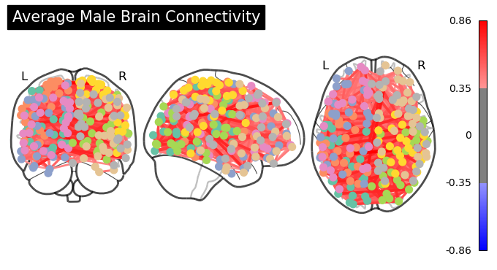
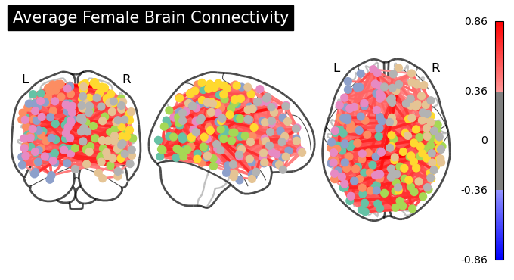
Minimum Viable Product (MVP) Evaluation
Sex-Based Differences in Brain Connectivity
Connectivity Difference Statistics (Female - Male):
Maximum positive difference: 0.0873
Maximum negative difference: -0.1151
Mean absolute difference: 0.0146
Standard deviation of differences: 0.0185
Top 5 strongest differences between female and male connectivity:
Region 184 - Region 185: Difference = 0.0873
Region 80 - Region 185: Difference = 0.0843
Region 76 - Region 184: Difference = 0.0799
Region 76 - Region 80: Difference = 0.0797
Region 131 - Region 185: Difference = -0.1151

Slide 18
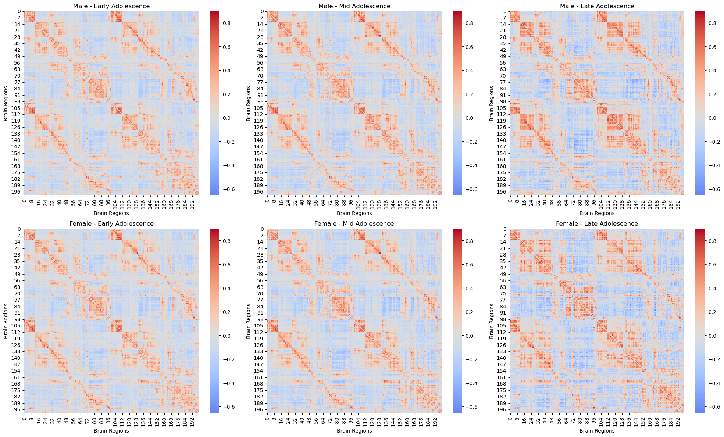
Minimum Viable Product (MVP) Evaluation
Brain Connectivity Between Sexes
Male Development:
Early to Mid Adolescence Change: -0.0094
Mid to Late Adolescence Change: 0.0002
Average Yearly Change: -0.0011
Female Development:
Early to Mid Adolescence Change: -0.0123
Mid to Late Adolescence Change: 0.0114
Average Yearly Change: -0.0001

Slide 19
Final Contemplation
What Could Have Made Our Project More Meaningful & Accurate
Expanded Dataset: Use a larger and more diverse dataset with balanced age and gender representation to enhance model robustness and reduce bias.
Better Model Interpretability: Leverage Graph Neural Networks (GNNs), which outperform traditional regression in understanding complex, high-dimensional neuroscience data.
Clinical Collaboration: Involve clinical experts to ensure the model’s relevance in real-world diagnosis and personalized care (e.g., ADHD, anxiety, depression).
Specialized Models: Develop generalized predictive models tailored to specific mental health conditions for greater clinical impact.

Slide 20
Final Contemplation
Lessons Learned
Practical Data Science Skills: Gained hands-on experience in CRISP-DM methodology, Agile teamwork, project planning, and risk management.
Data Preparation is Key: Learned the importance of preprocessing and model-specific data tuning to optimize performance.
Multi-perspective Problem Solving: Adopted a holistic, exploratory mindset—essential for uncovering deeper insights and tackling future data challenges.

Slide 21
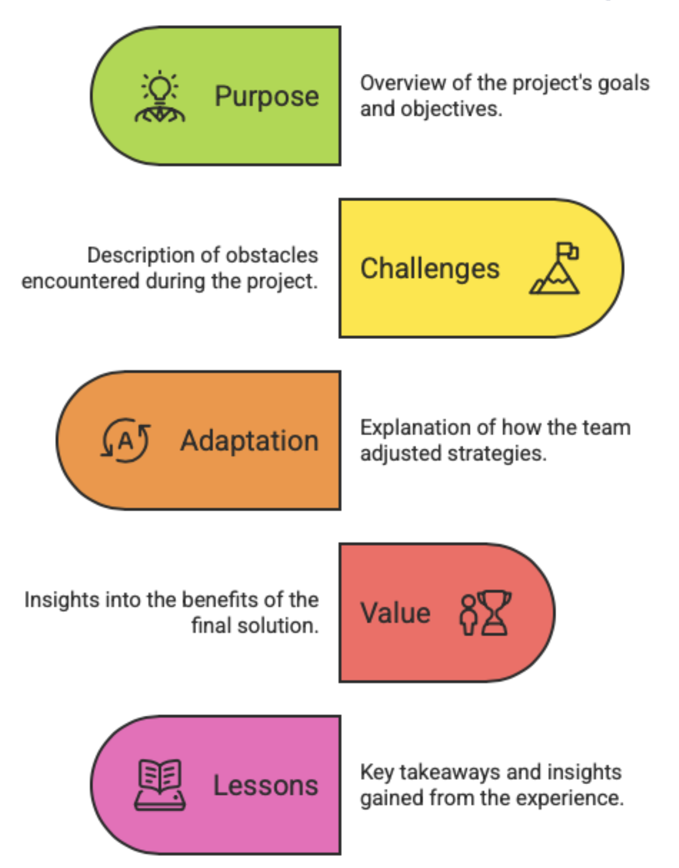

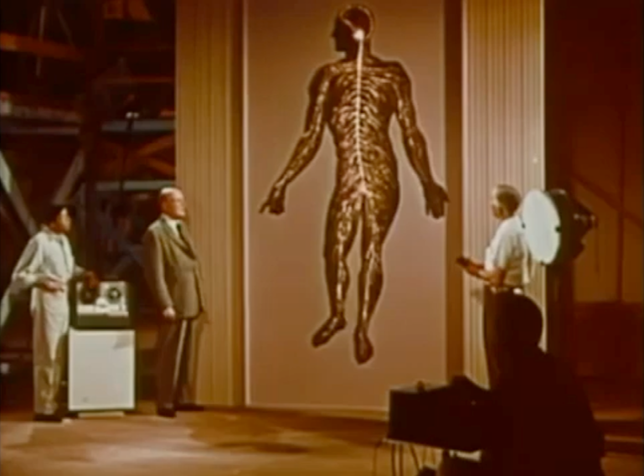
Our Project Journey in 2 Minutes

Slide 22


Slide 23
THANK YOU
For Your Attention
WiDS Datathon 2025
#WiDSDatathon

